Slide 1
Multi-Site Enterprise Network Design and Implementation.
Network Design, Configuration and Implementation
Presented BY: Purva Bhujbal

Slide 2
Introduction
A company network connects different departments, offices, servers, and management systems.
The project focuses on designing a structured and interconnected company network.
The network is divided into Main Office, Branch Office, Management Network, and External Network.
Routers and switches are used to connect different network segments.
Important networking services and protocols are configured and tested.
The complete network is designed and implemented using Cisco Packet Tracer.

Slide 3
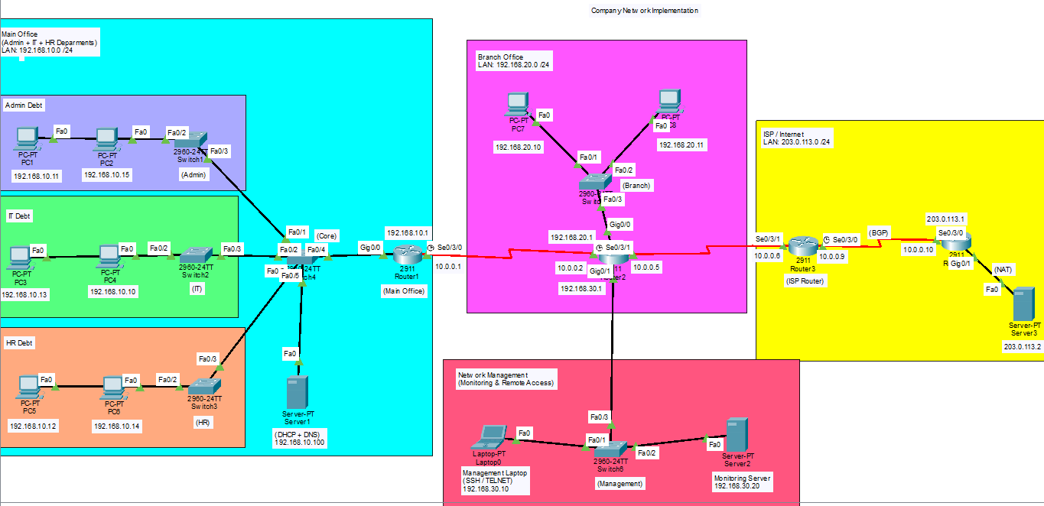
Topology
TOPOLOGY

Slide 4
Objectives
Design a structured network for different company departments and locations.
Configure IP addressing for the different network segments.
Implement DHCP and DNS for network services.
Configure OSPF, RIP, and BGP for communication between networks.
Implement NAT for external network communication.
Enable remote management using SSH and Telnet.
Test and verify the configured network using appropriate commands and simulations.

Slide 5
How This Project Supports Industries
Connects multiple offices and departments through one network.
DHCP and DNS make network management easier.
OSPF, RIP and BGP provide reliable communication between networks.
NAT enables external network connectivity.
SSH and Telnet support remote device management.
The network can be expanded as the organization grows .
Industry Applications:
IT Companies • Banking • Education • Healthcare • Multinational Companies

Slide 6
Network Components
Network Devices
Routers: R1, R2, R3, R4 — connect different networks and handle routing.
Switches: SW1–SW6 — connect devices within the different network sections.
End Devices: PCs and Management Laptop — represent users and administrative access.
Servers
Server1: DHCP and DNS services for the Main Office.
Server2: Monitoring Server for the Management Network.
Server3: External Server representing the external network.
Networking Technologies
IP Addressing , DHCP & DNS, ARP, OSPF, RIP & BGP, NAT, SSH & Telnet

Slide 7
IP Addressing
Network Section | Network Address | Gateway
Main Office | 192.168.10.0/24 | 192.168.10.1
Branch Office | 192.168.20.0/24 | 192.168.20.1
Management Network | 192.168.30.0/24 | 192.168.30.1
R1 – R2 Link | 10.0.0.0/30 | -
R2 – R3 Link | 10.0.0.4/30 | -
R3 – R4 Link | 10.0.0.8/30 | -
External Network | 203.0.113.0/24 | 203.0.113.1
DHCP is used for Main Office PCs, while servers, routers, branch devices, and management devices use assigned static IP addresses.

Slide 8
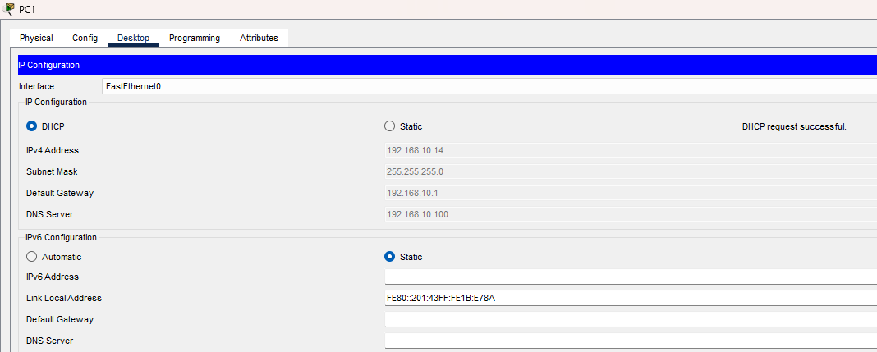
DHCP-Dynamic Host Configuration Protocol
Automatically assigns IP addresses to devices.
Provides subnet mask, default gateway, and DNS.
Configured on Server1.
Used for Main Office PCs.
Reduces manual IP configuration.
Example: PC1 received 192.168.10.14 automatically

Slide 9
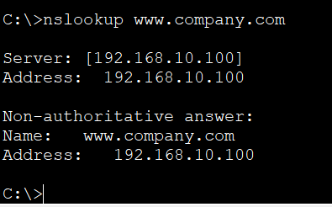
DNS = Domain Name System.
Converts domain names into IP addresses.
Configured on Server1.
DNS Server: 192.168.10.100
Domain: www.company.com
Resolves the domain to 192.168.10.100.

Slide 10
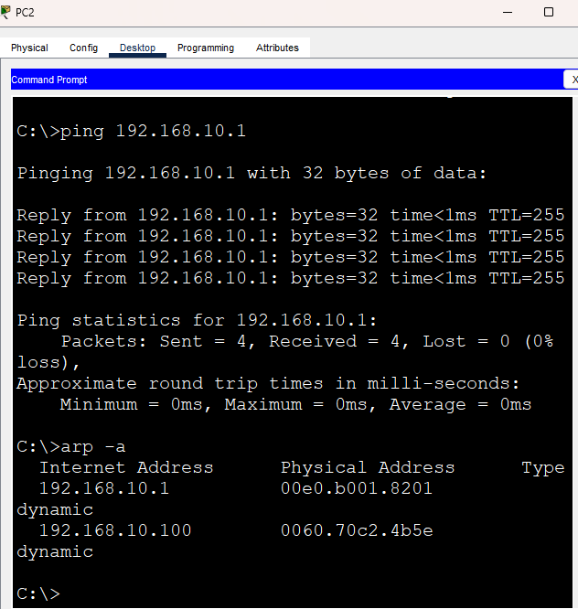
Address Resolution Protocol (ARP)
Finds the MAC address using an IP address .
Used within the same local network (LAN)
In my topology, it is used in the Main Office network
Helps PCs communicate with each other and the gateway
Tested using arp -a

Slide 11
Routing Protocols
Routing protocols determine how data packets travel between different networks. In our project, three routing protocols are implemented for different parts of the network:
OSPF (Open Shortest Path First)
Used between R1 and R2 for routing within the internal network.
RIP (Routing Information Protocol)
Used between R2 and R3 to exchange routing information.
BGP (Border Gateway Protocol)
Used between R3 and R4 to demonstrate routing between different autonomous systems.
R1 → R2: OSPF | R2 → R3: RIP | R3 → R4: BGP

Slide 12
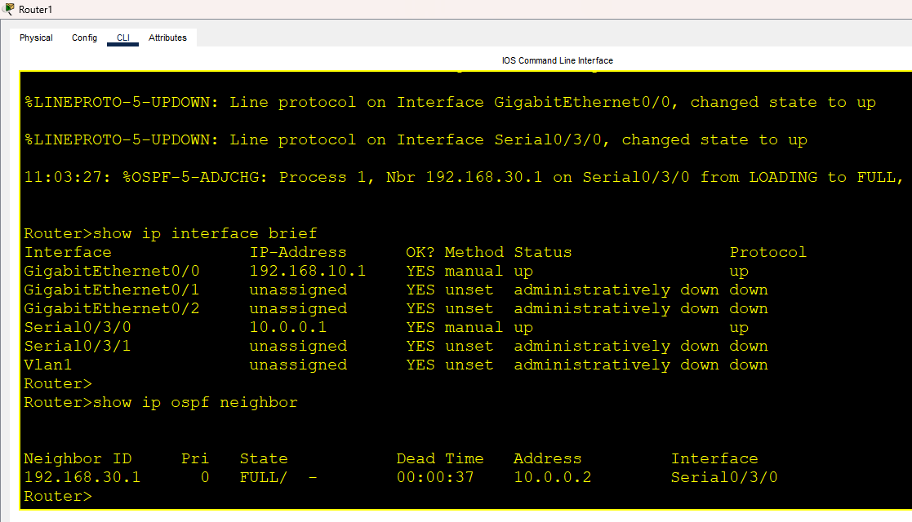
OSPF — Open Shortest Path First
OSPF is a link-state routing protocol.
Configured between R1 and R2.
Uses network information to determine the best available path.
Helps routers exchange routing information.
Area 0 was used in the project.
Verified using: show ip ospf neighbor.

Slide 13
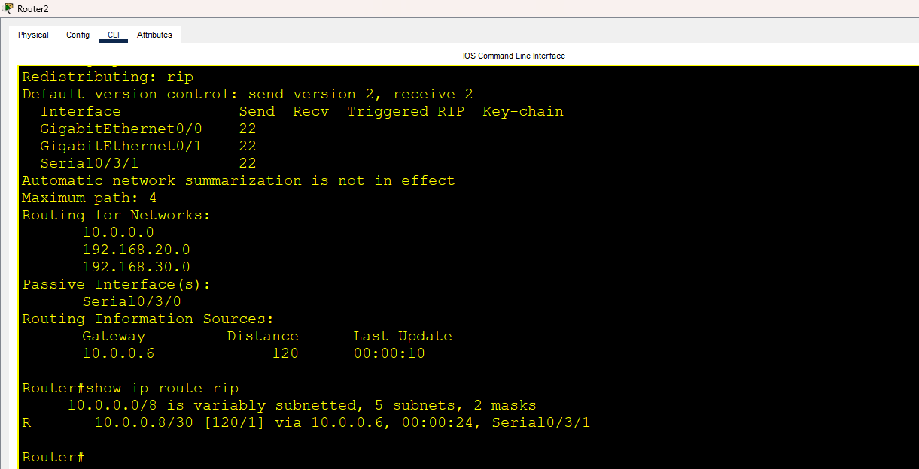
RIP - Routing Information Protocol
RIP is a distance-vector routing protocols.
Configured between R2 and R3.
Uses hop count to select a route.
Helps exchange routing information between routers.
RIP version 2 was used in the project.
Verified using show ip route rip.

Slide 14
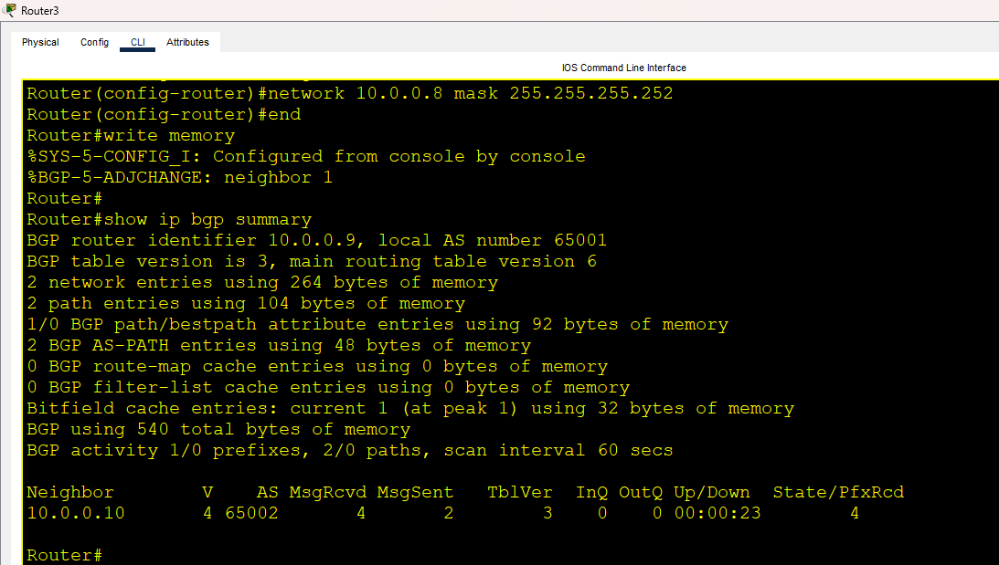
BGP — Border Gateway Protocol
BGP is a path-vector routing protocol.
Configured between R3 and R4.
Used to exchange routing information between different networks.
BGP neighbor relationship was established.
Verified using show ip bgp summary.

Slide 15
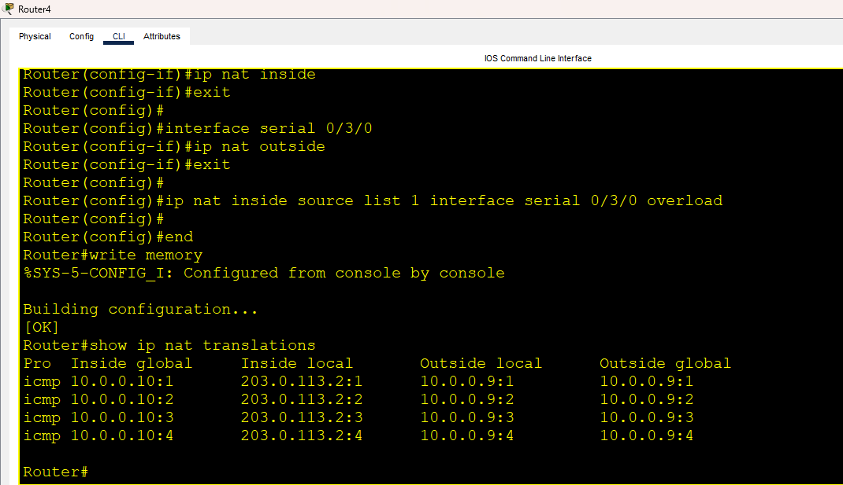
NAT — Network Address Translation
NAT translates IP addresses when data moves between different networks.
Configured on R4.
Helps provide communication with the external network.
NAT was tested using network traffic.
Verified using show ip nat translations.

Slide 16
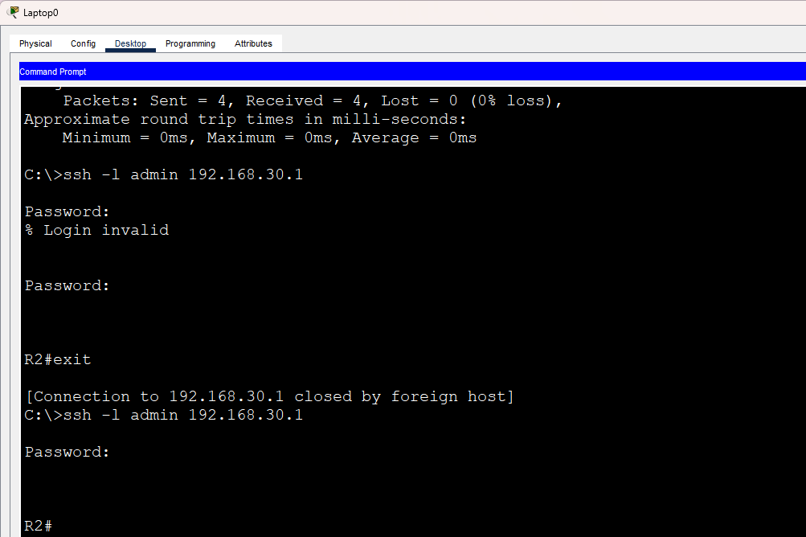
SSH — Secure Shell
SSH provides secure remote access to network devices.
Configured on R2 for remote management.
SSH was enabled Version 2.
A username and password were configured for authentication.
The Management Laptop was used to access R2 remotely.
Verified using: show ip ssh.

Slide 17
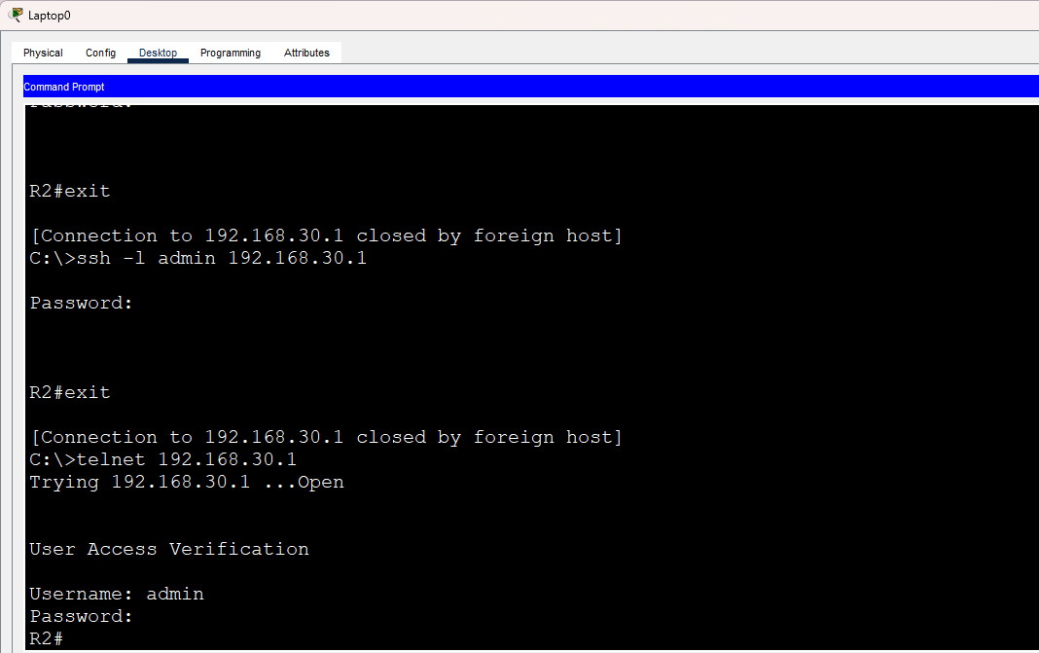
Telnet
Provides remote access to a network device through a terminal.
Configured on R2 for remote management.
Management Laptop was used to connect to R2.
Username and password authentication was configured.
The Telnet connection was successfully tested.

Slide 18
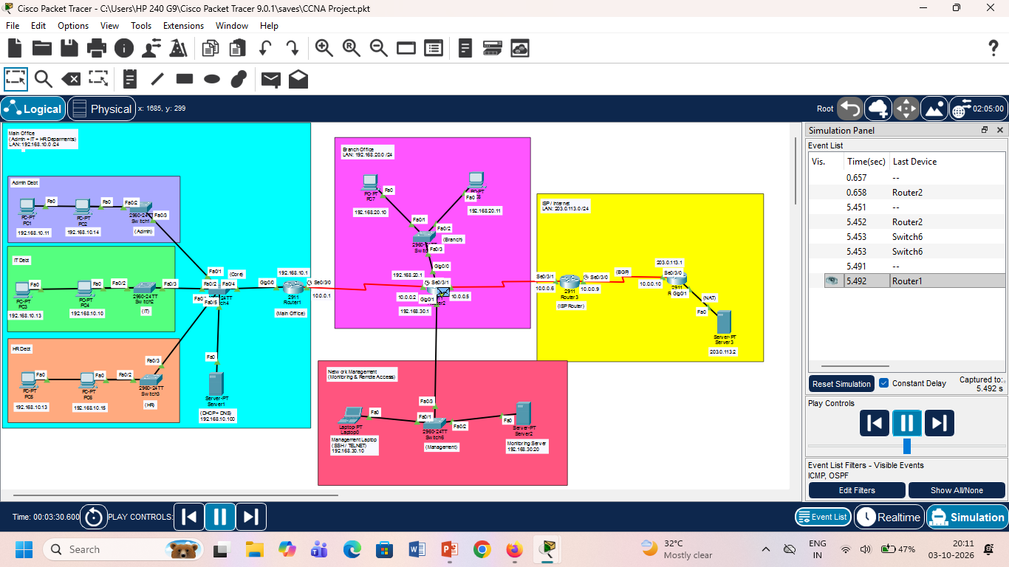
Packet Forwarding
Routers forward packets from the source network to the destination network.
The destination IP address is checked to determine the route.
Routing tables identify the appropriate next hop.
OSPF, RIP, and BGP provide routing information.
Packet movement was observed using Simulation Mode in Cisco Packet Tracer.
Connectivity was verified through ping tests.

Slide 19
Testing & Results Content
The configured network was tested to verify connectivity, routing, and network services.
DHCP: Main Office PCs successfully received IP addresses automatically.
DNS: The configured domain name resolved to the assigned IP address.
OSPF: R1 and R2 successfully established an OSPF neighbor relationship.
RIP: R2 and R3 exchanged routing information successfully.
BGP: R3 and R4 established a BGP session between AS 65001 and AS 65002.
NAT: Address translation was verified on R4.
SSH & Telnet: Remote access to R2 was successfully tested from the Management Laptop.
Connectivity: Network interfaces and selected routes were verified using ping and router commands.

Slide 20
Challenges Faced During the Project
DHCP was initially not assigning IP addresses to PCs.
One switch connection was down, affecting connectivity.
Configuring multiple routing protocols was challenging.
SSH, Telnet, and NAT required careful configuration and testing.
Troubleshooting was needed to identify and fix network issues.

Slide 21
How Issues Were Resolved
Checked cable connections and device interfaces.
Verified IP addresses and DHCP settings.
Corrected the switch connection that was down.
Used network commands to verify routing and protocols.
Tested connectivity using ping and simulation mode.
Rechecked configurations after making changes

Slide 22
Conclusion
Successfully designed and implemented a multi-site enterprise network.
Connected the Main Office, Branch Office, Management Network, and External Network.
Implemented DHCP, DNS, ARP, OSPF, RIP, BGP, and NAT.
Configured SSH and Telnet for remote device management.
Tested network connectivity and verified protocol operation.
Gained practical experience in network configuration, routing, and troubleshooting.

Slide 23
THANK YOU

